Slide 1

What is the reason for so many late deliveries in sporting goods?
The type of story is: “start big and drill down”.
The audience is retail corporations and transportation companies.
Tyler mann / 7/18/2021

Slide 2
What is the reason for so many late deliveries in sporting goods?
My data story is looking at retail sporting goods late deliveries starting big and drilling down. I start looking at average shipping days vs. real shipping days overall, region late deliveries, country late deliveries, product late deliveries, and lastly the most problematic cities and products for conclusion.
Data analysis | Kaggle
Late Delivery: Deliveries not on time
Order Item Quantity: Number of products per order

Slide 3
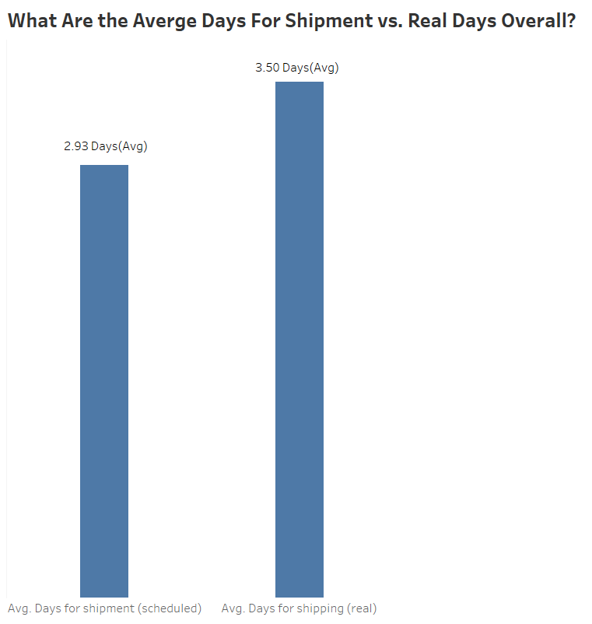
Are the actual vs. real days close?

Slide 4
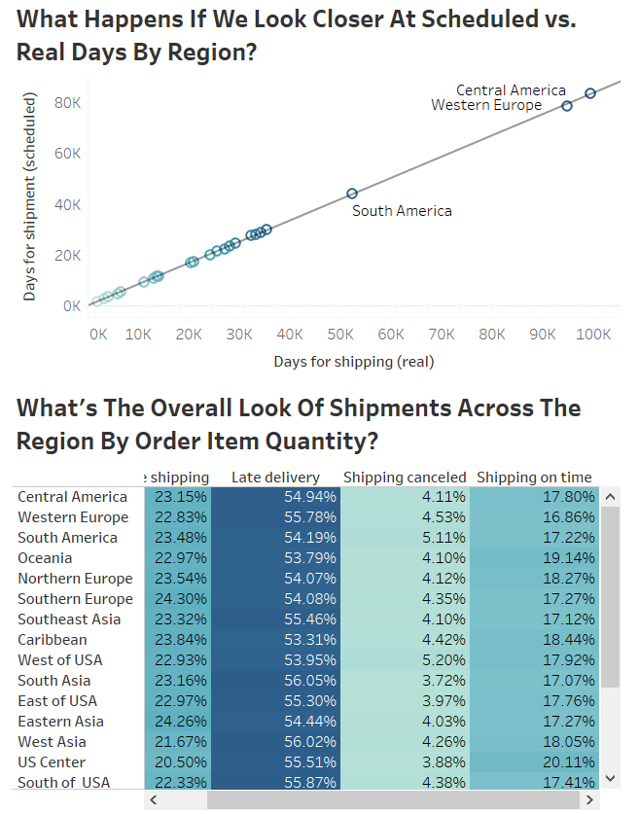
Are there outliers based on shipping by region?

Slide 5
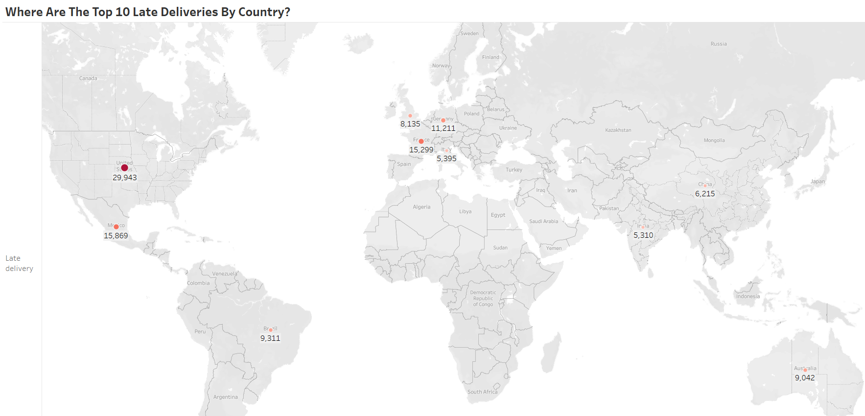
What countries stand out for late deliveries by order item qty?

Slide 6
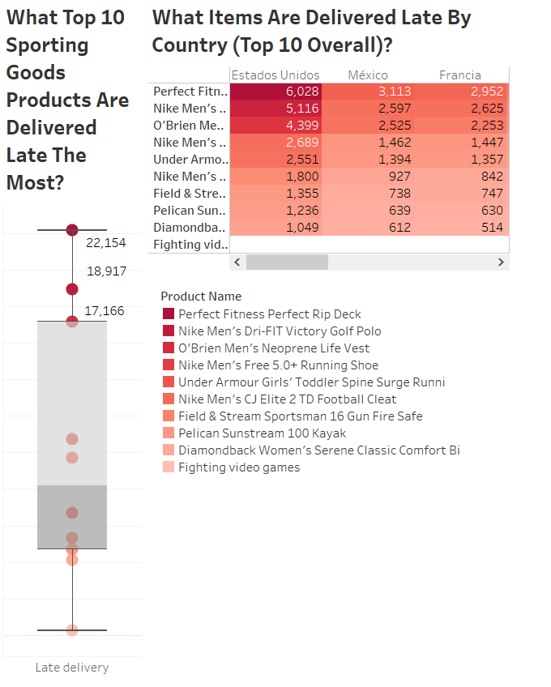
Where are the most popular products problematic by country?

Slide 7

What Will we find if we look at the worst cities?

Slide 8
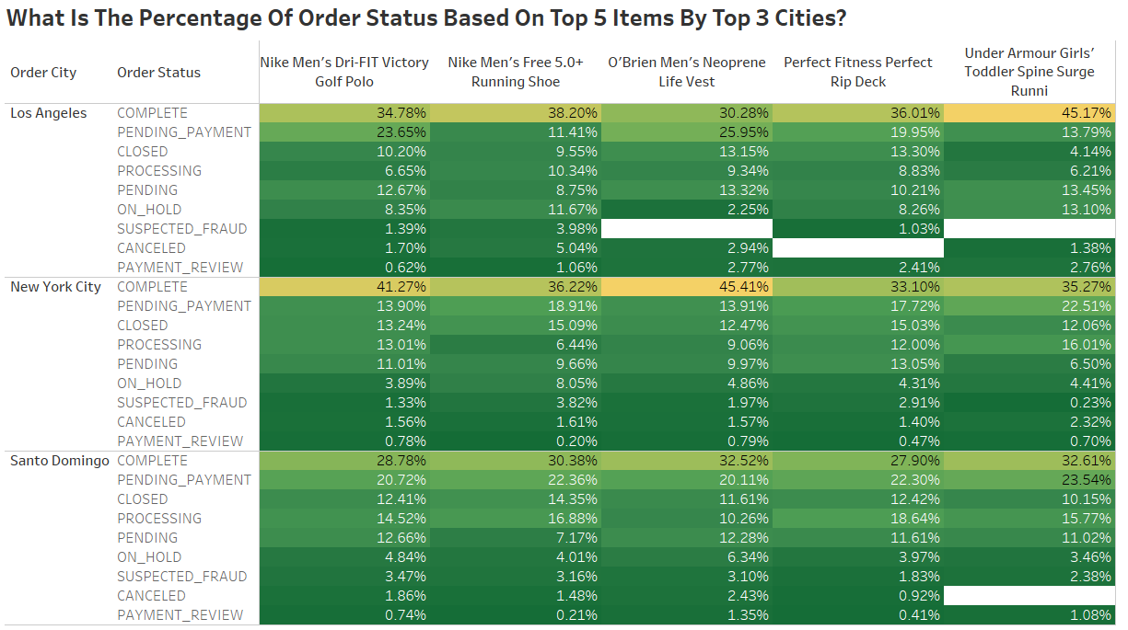
What is the reason for so many late deliveries in sporting goods?

Slide 9
What is the reason for so many late deliveries in sporting goods?
The audience is retail corporations and transportation companies.
The retail corporations should look for ways to resolve those pending payments.
Orders that are currently “PROCESSING” need to be processed as soon as possible.
Orders that are “ON HOLD” need to be reviewed and resolved.
Look into cancellations, are they because of delivery or payment issues? Have customer service investigate this and fraud cases.
Find a more efficient way to review payments.
Lastly, get with transportation and collaborate on ways to lower actual vs. real days.

